Slide 1
Faculty Senate Update
Robert Marley, Provost
April 25, 2019

Slide 2
Updates
Vice Provost, Enrollment Management
Paul Orscheln, Assoc. Vice President, Enrollment Mgmt. and Student Retention, Missouri Western State University
Effective June 1, 2019
Vice Provost and Dean, Library
Hsin-liang (Oliver) Chen
Effective July 1, 2019

Slide 3
Additional Searches
UM System Chief eLearning Officer
4 candidates to be interviewed next week in Columbia (and telepresence)
Considerations of our VP of Global Learning search
Selection of eLearning service vendor
1996…

Slide 4
THANK YOU!
QUESTIONS?

Slide 5
Division Updates
Faculty Senate Meeting
Thursday, April 25, 2019

Slide 6
March 2019
Major Accomplishments
Irina Ivliyeva announced as new CAFE assistant chair effective June 1, 2019
Pilot Ten Steps to Teaching Success program: 24 faculty from 15 departments registered, active within 5 cohorts
Teaching and Learning with Technology Conference successfully administered with 206 attendees representing over 50 educational institutions
Early career faculty forums: March 20 – History of S&T and dinner with spouses; April 3 – What’s Important in Service?
Letters of intent received from 22 faculty representing 20 proposals for potential Educational Research Mini-Grants
Coordinator position advertised, applications collected and reviews, and interviews scheduled
Immediate Plans
Collaborate with Astrid Villamil of UM System and Neil Outar to offer Inclusive Teaching workshop for faculty on April 8
Interviews scheduled for CAFE Coordinator position, aim to select candidate and hire with start date of late April
Travel to MSU Engineering Cooperative April 5th to offer CAFE services to S&T faculty at MSU
Continue intercampus collaborations with Teaching and Learning Centers of UM System
Upcoming Events
“Crafting and Effective Teaching Philosophy Statement”, with the Miner Master Mentors, April 1st from 2:15 – 4:15
“Creating and Inclusive Classroom”, with Astrid Villamil and Neil Outar, April 8th from 12:15 – 1:45pm
Early Career Faculty Forums: Travel Grant Experiences from Early Career Faculty, April 17th ; Promotion & Tenure at S&T (TT and NTT sessions), May 1st
Miner Master Mentors Drop-In Hours: April 5, 8, 12, 18, 25, 30 & May 10
CAFE Spotlight
Meet the Miner Master Mentors team through these short videos:
Dr. Bill Fahrenholtz, Professor of Materials Science & Engineering
Dr. Irina Ivliyeva, Professor of Arts, Languages, & Philosophy
Dr. Scott Miller, Teaching Professor of Materials Science & Engineering

Slide 7
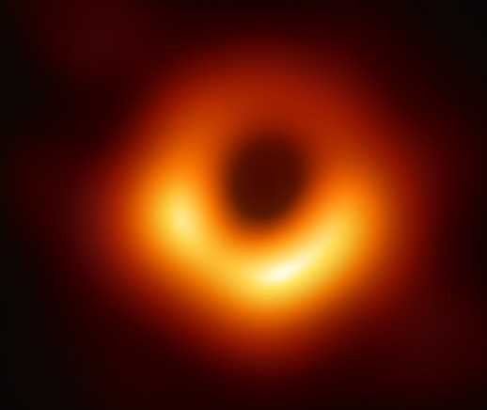
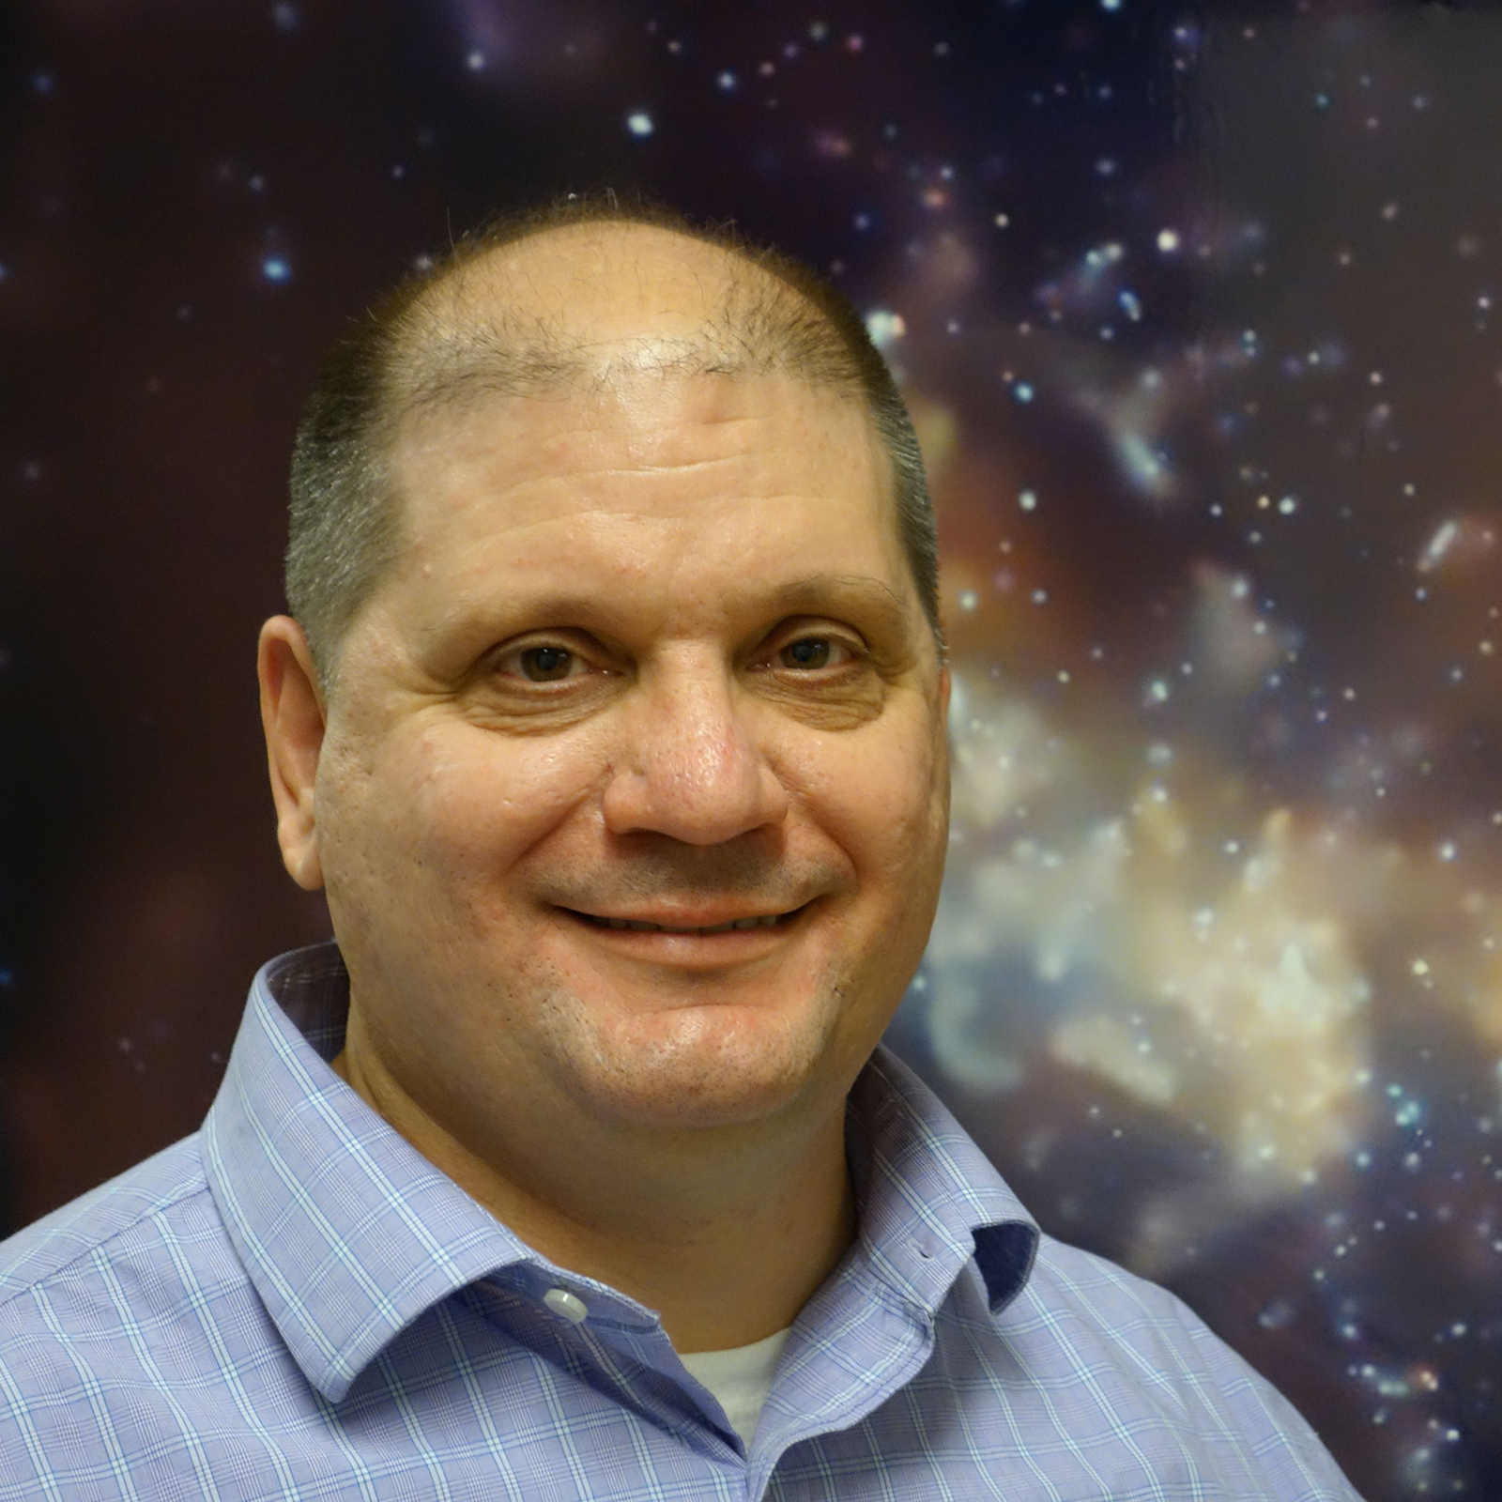
College of Arts, Sciences, and Business
Dr. Frederick Baganoff, (Physics ‘85) is among the collaborators on the international Event Horizon Telescope project to produce first direct images of a black hole.

Slide 8
Office of Sponsored Programs
Summary of FY19 activities year-to-date (March)
Number of funded proposals is a total of 232
Total dollars is $32.5M
Number of new proposals submitted is 442
Total dollars is $138.6M
Total expenditures is $30.6M
Net grant and contract expenditures is $23M
F&A recovered is $4.9M

